Slide 1
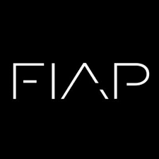

Operating System Tuning and Cognation
Chatbot
The Movie DataBase
Prof. Sérgio Ricardo Rota pf0112@fiap.com.br www.fiap.com.br

Slide 2
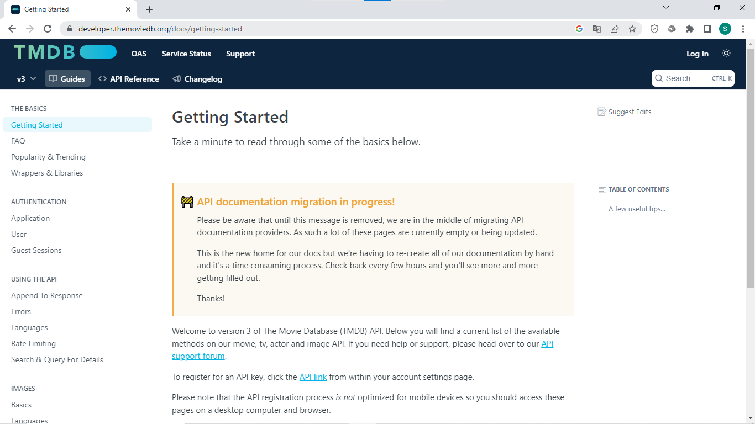
The Movie DataBase
https://developer.themoviedb.org/docs/getting-started
2

Slide 3
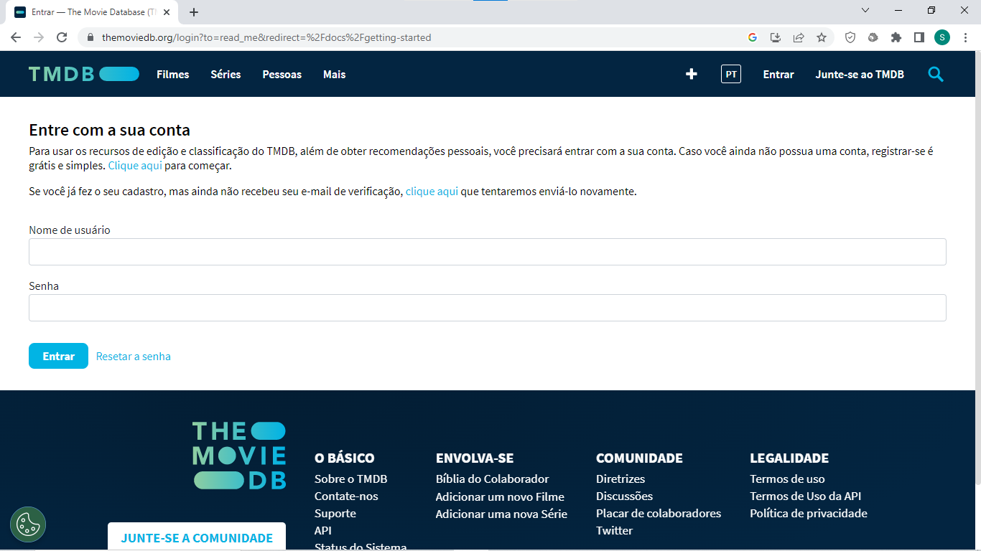
The Movie DataBase
3

Slide 4
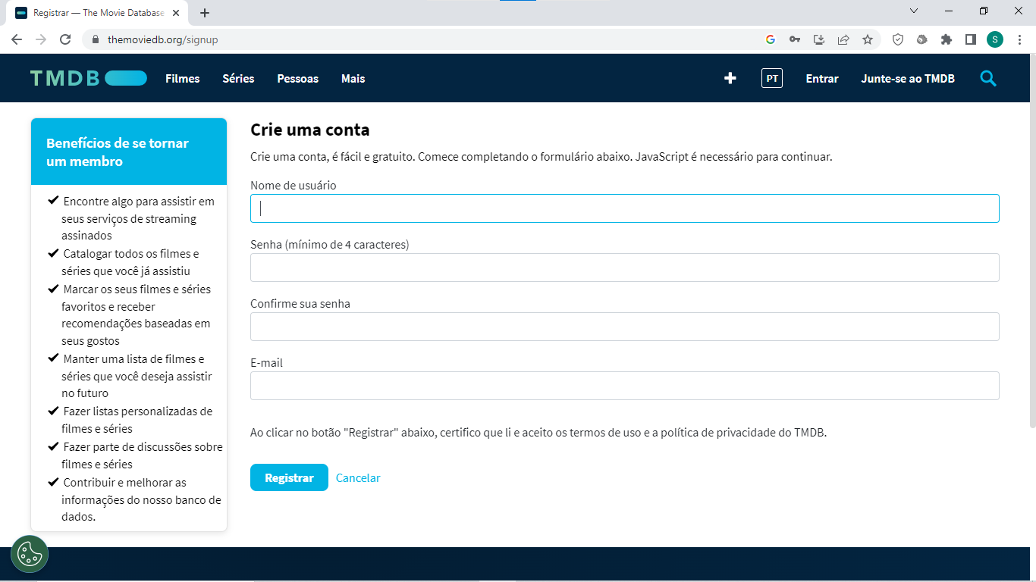
The Movie DataBase
4

Slide 5
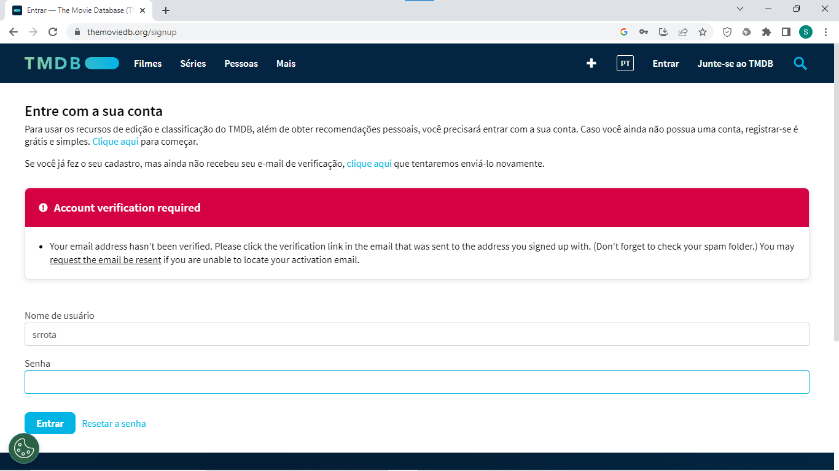
The Movie DataBase
5

Slide 6
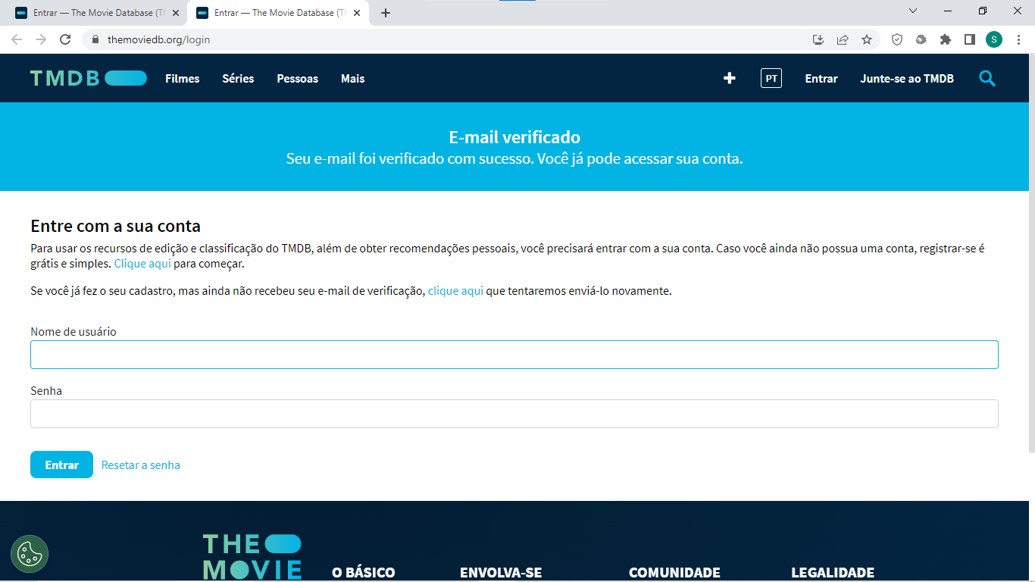
Chatbot – fluxo de conversação, Gallery
6

Slide 7
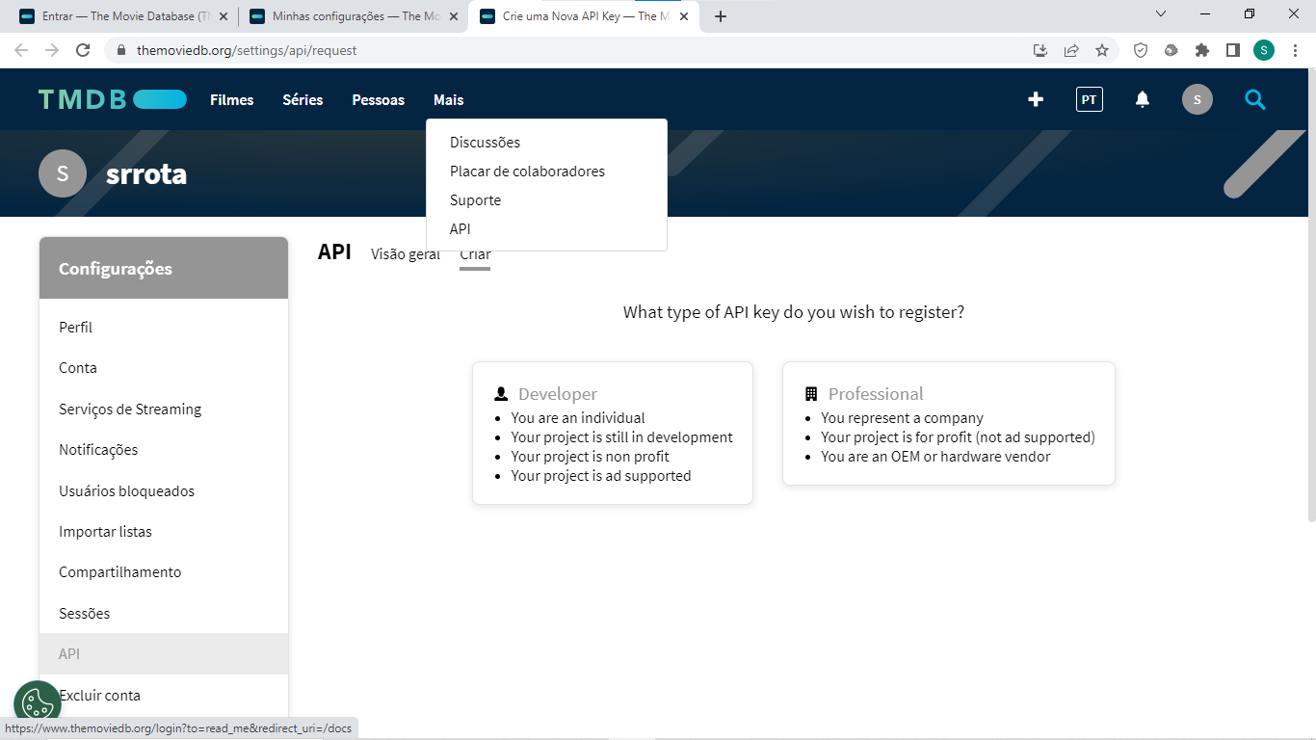
The Movie DataBase
7

Slide 8
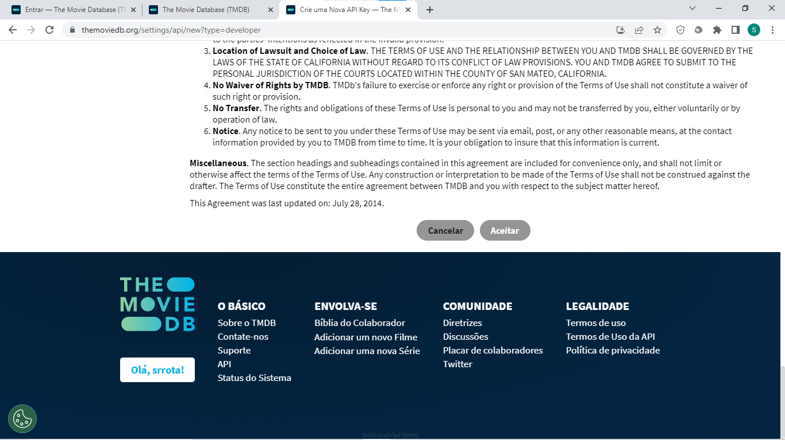
The Movie DataBase
8

Slide 9
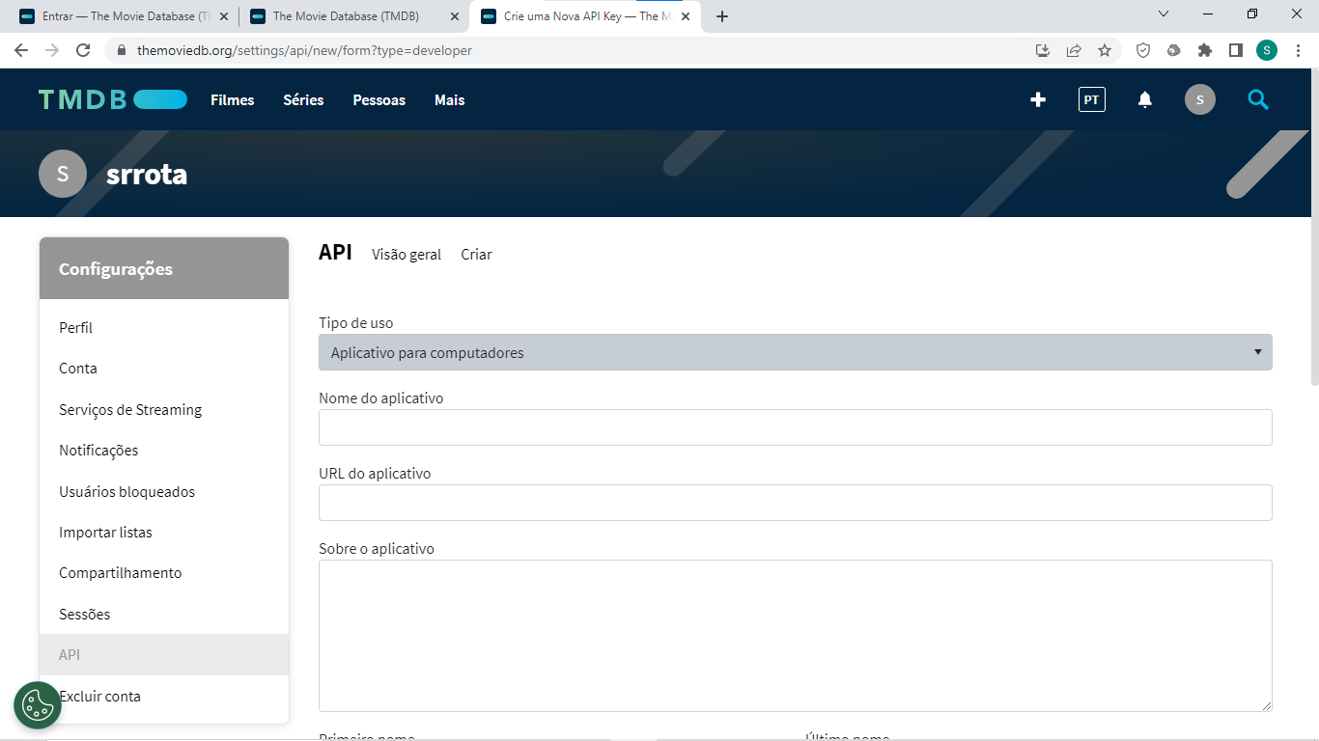
The Movie DataBase
9

Slide 10
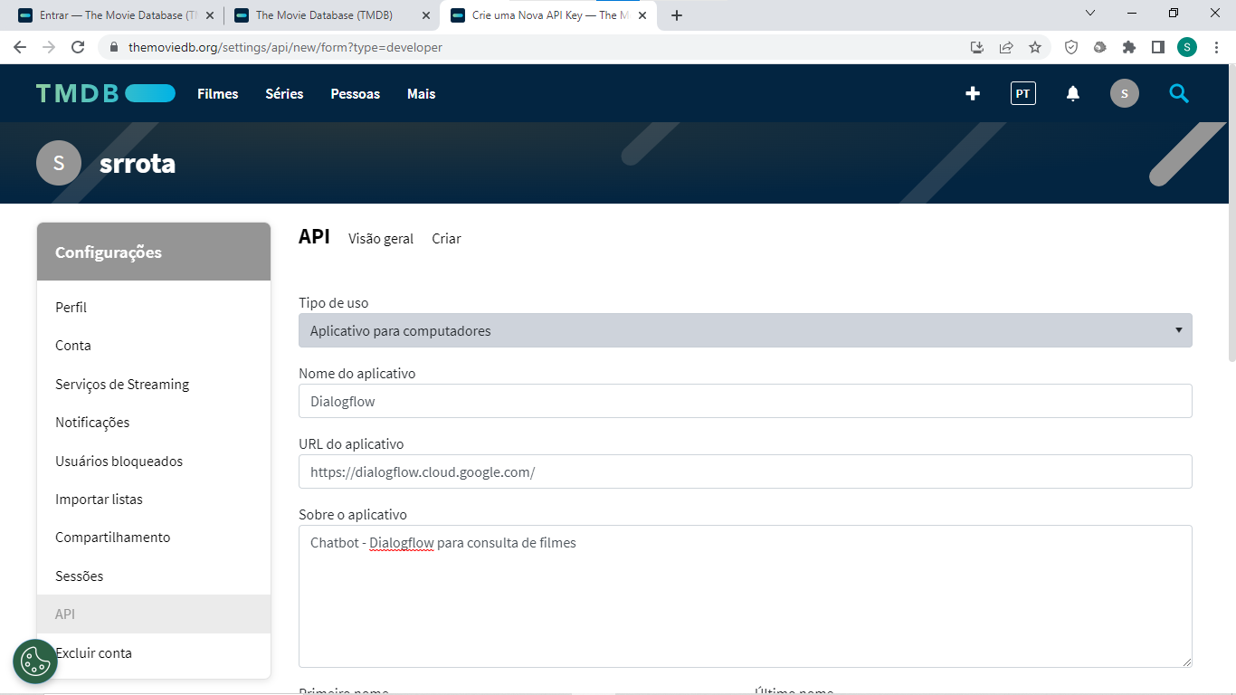
The Movie DataBase
10

Slide 11
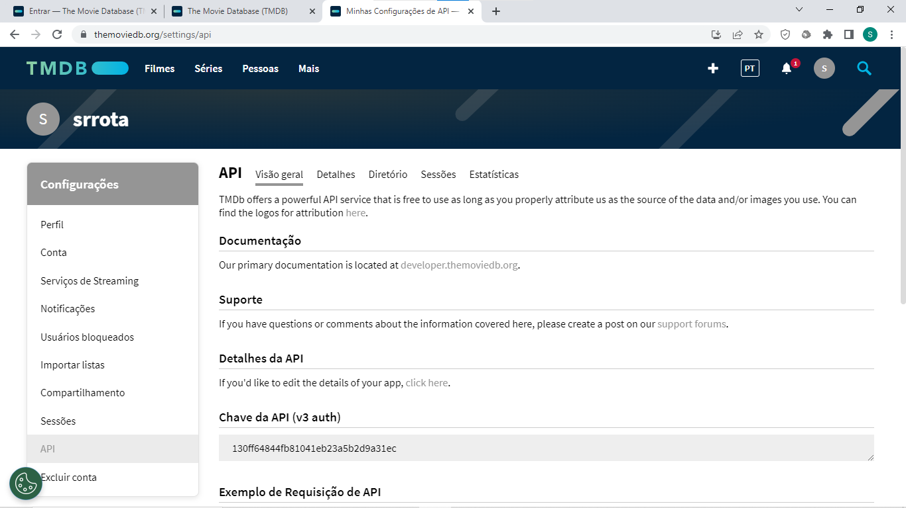
The Movie DataBase
11

Slide 12
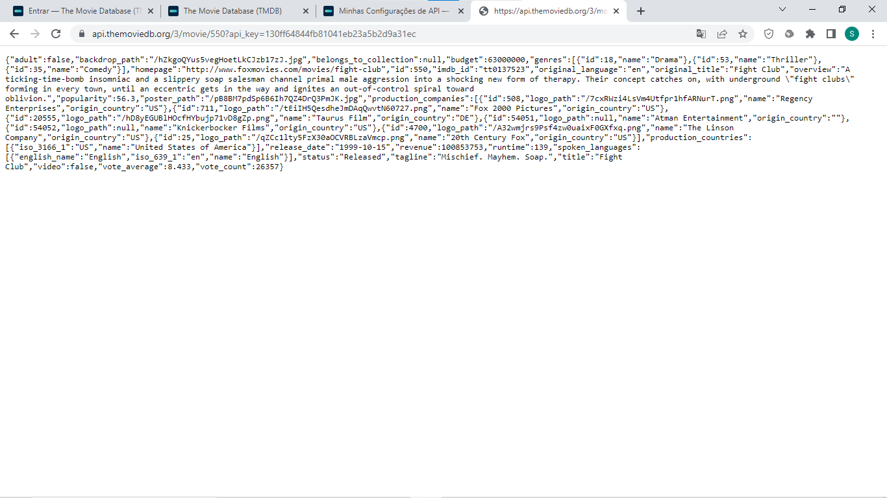
The Movie DataBase
12

Slide 13
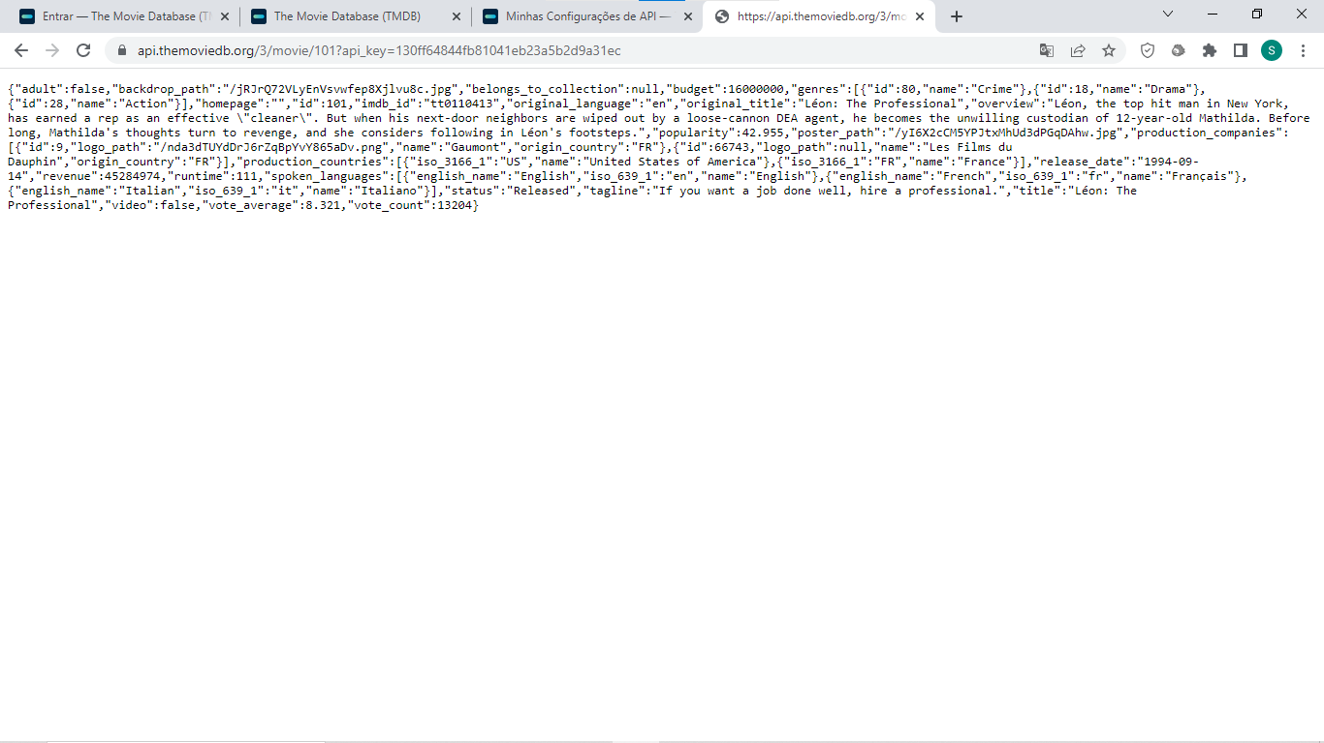
The Movie DataBase
13

